Slide 1
What Are They In?
Brandon Ching, Nikola Peevski, Scott Wilde, Cecilia Cortez, Akshat, Gangbin Lee

Slide 2
Quick Overview
What Are They In?
Identify actors and actresses while watching TV shows/movies by just taking their picture.
App shows the actors name, picture, and filmography from IMDB dataset.
Recently searched area for users to avoid re-scanning already searched actors.
iOS application

Slide 3
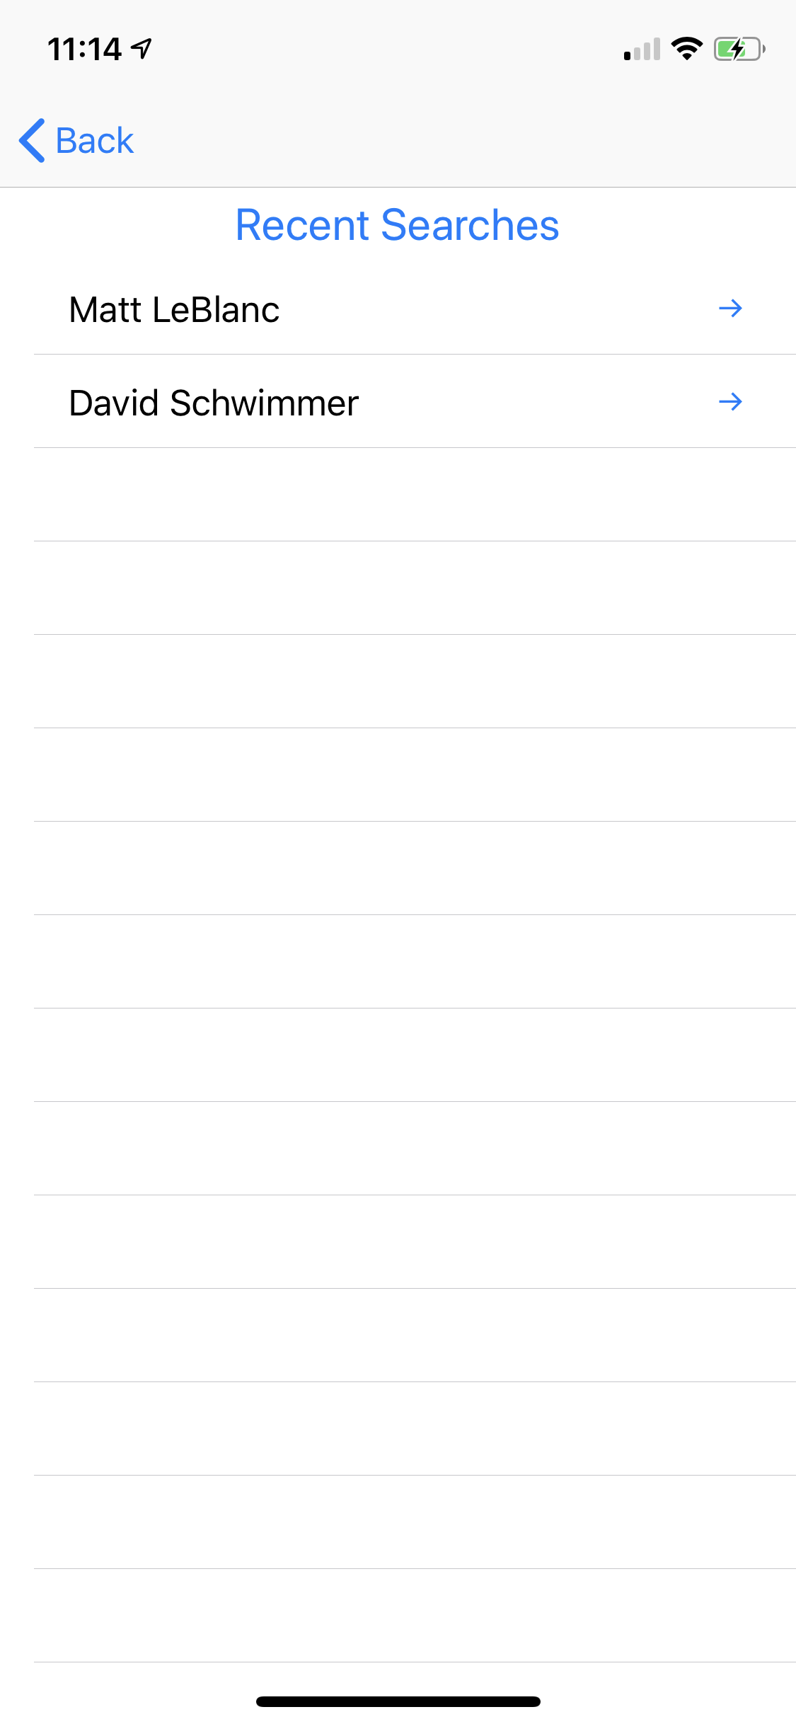
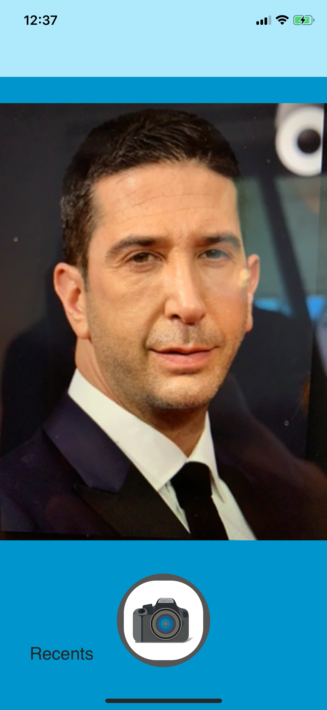
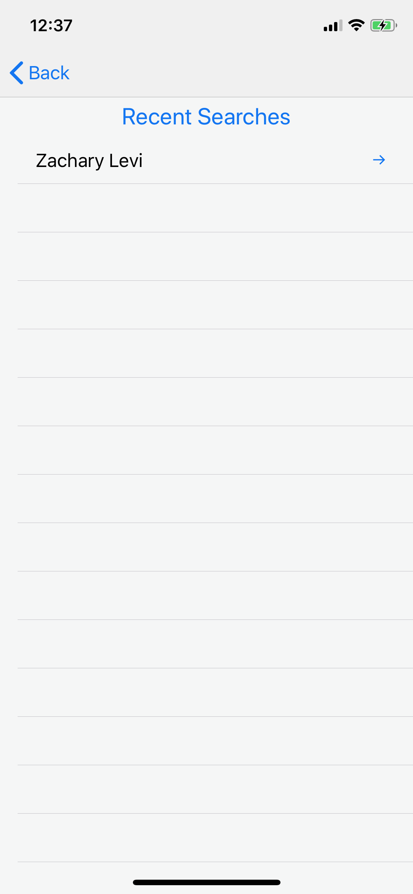
User Interface of App

Slide 4
Tools Used
Swift
IMDB API
Tensorflow
NodeJS
GitHub

Slide 5
Accomplished so far...
We transitioned our application from being locally hosted to being virtually hosted.
The application allows a picture to be taken and sent through our server to return the actors’/actress’ name and his details.
Currently working on cast of Friends and The Office as a proof of concept.
We have set up unit tests/implemented a testing strategy for each area? of our application.

Slide 6
Problems encountered so far...
We had to create a proof of concept and limit the number of actors/actresses we are able to detect due to runtime concerns.
We encountered a bug with the user’s view of the camera after taking one picture.
Parsing of the JSON containing all the actor’s/actress’ information has taken longer than expected

Slide 7
What we’ve learned...
Communication is key!
Make sure everyone is on the same page.
Tackle problems in segments, and don’t get overwhelmed.
Design code for testability.
Connecting everything to Server took longer than expected.

